Slide 1
Absent Predictions
File created on: 08.02.2021 1:30:13

Slide 2
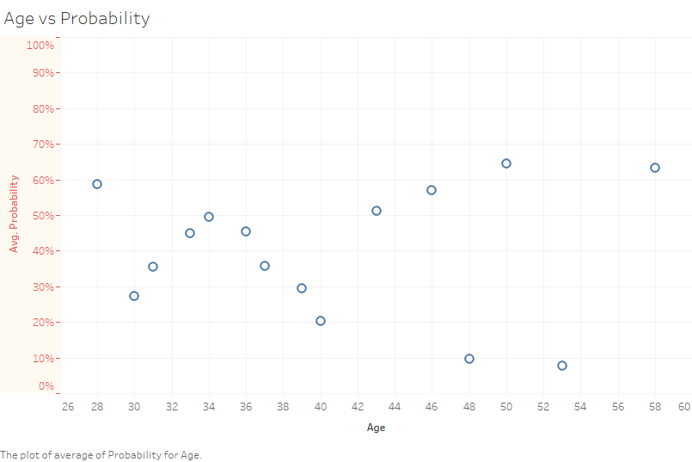

Slide 3
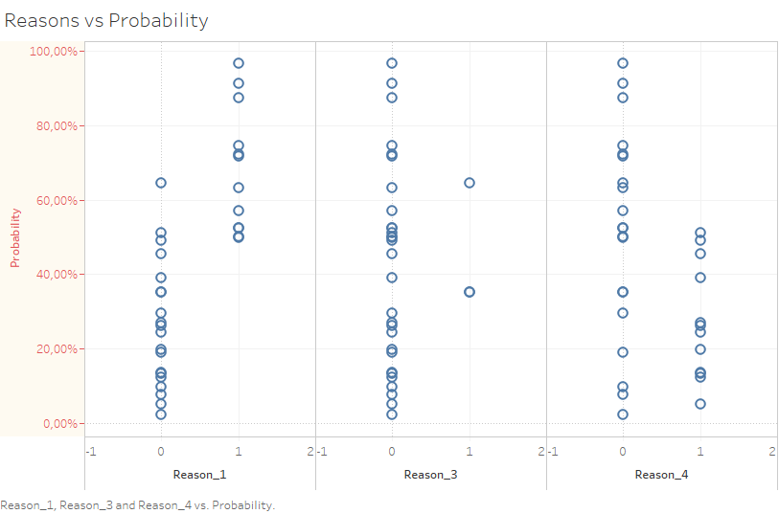

Slide 4
